Slide 1
CORPORATE BOOKING TOOL
Caxita Tech Solutions Pvt. Ltd.
USER DOCUMENTATION
Version: 1.0
Created on: 4 Jan 2026

Slide 2
CBT Documentation
Purpose:
This documentation serves as a reference for understanding and utilizing the Caxita Corporate Booking Tool (CBT) functions to manage corporate clients.
Introduction (CBT)
In today’s dynamic and globally connected corporate landscape, efficient management of employee travel is a strategic necessity rather than an administrative task. Large organizations often oversee extensive travel activities involving multiple departments, regions, and
budgets. Without a unified solution, managing these activities can lead to inefficiencies such as fragmented processes, lack of visibility,
and unnecessary costs. The Corporate booking Tool is an advanced enterprise solution designed to digitize, centralize, and optimize every aspect of corporate travel management. It serves as an end-to-end platform that integrates travel planning, booking, approvals, and
analytics within a single, cohesive environment. By leveraging automation, workflow intelligence, and real-time reporting, CBT enables organizations to enforce travel policies, , and gain strategic insights into travel behavior and spending patterns. Beyond operational
efficiency, CBT is a strategic business tool that supports corporate governance, financial control, and employee satisfaction. It ensures
policy compliance, minimizes manual intervention, and provides management with actionable data to support decision- making and cost optimization.
www.caxita.com

Slide 3


Work Flow
This workflow outlines the mandatory sequence of steps to configure a new corporate , from initial creation in the
Back Office to full user onboarding in the Corporate Admin panel.
Booking Engine Admin Branch Unit Creation Main Branch Setup Booking Engine Admin Supplier & Payment Gateway Configuration (Against Branch)
Corporate Admin Panel (Super-admin logs in) Add Corporate User (corporater user logs in) Region setup Region user(logs in) Company
Structure(department) Organization Setup (Roles and
Permissions,Designation,Hierarchy, Purpose of travel, Travel policy) Employee & Dependent On-boarding Approval Workflow Execution.
www.caxita.com

Slide 4
Phase 1: Core Client Setup (CBT Back Office)
Step | Action | CBT Administration Workflow: End-to-End Setup Purpose
1 | Create Branch Unit | Establishes the main corporate client (e.g., ‘FedEx’) and defines its financial limits (Credit Limit).
2 | Create Main Branch | Next, create the Main Branch (e.g.,FedEx Dubai ,FedEx Kuwait). This action links these physical offices directly to the main company established in step 1
3 | System Management - API Management | Map each main branch to the respective APIs. In Supplier Configuration, enable the providers that need to be displayed on the front end.
4 | Transition to Corporate Admin | Log into the Corporate Admin portal to continue the setup.
Phase 2: Building the Organization (Corporate Admin)
Step | Action | Menu Path | Key Requirement
5 | Logs in as Super Admin and add Corporate User | Add the corporate user and link them to the newly created Branch Unit. | This is the initial user required to perform further process
6 | Create Region, Regional Unit | Use the Automatic Option (YES) to quickly create Region and Regional Unit with inherited credit limits . Manual Option (NO) manually the regions and the regional units can be created | Structural divisions
7 | Region User | The region user is auto-created, whereas the region and region unit can be created automatically or manually. | Password and username can’t be edited
8 | Logs in as region user and add Department | Create departments (e.g., 'Operations','finance'). MUST be mapped against a specific Regional Unit. | Password and username can’t be edited

Slide 5
Phase 3: Defining Rules and Roles (Organization Setup)
This phase establishes the access controls and the approval flow structure.
Step | Action | Menu Path | Purpose
9 | Create Roles & Permissions | Define system Access Roles (e.g., 'Approver') and their specific permissions. | Controls what a user can see and do within the system.
10 | Create Designation | Define all official Job Titles (e.g., 'Senior Manager') that employees will hold. | Provides the titles required for the hierarchy flow.
11 | Create Hierarchy Flow | Define the Approval Workflow sequence, which is built against each Department using the created Designations. | Establishes the mandatory chain of approval for all requests.
12 | Purpose of Travel | Define the travel purpose. | Defines the reason for travel, enabling policy compliance, approvals, and accurate reporting
Phase 4: Employee Onboarding
This is the final of assigning all users into the fully defined structure.
Step | Action | Menu Path | Purpose
5 | Onboard Corporate Employees | Complete all Profile, Credentials for each user. | CRITICAL: Onboard the Highest Authorized Person First. (The Reporting Manager must exist before their subordinates are onboarded).
6 | Assign Role & Reporting | Link the employee to the correct Department, Designation, Role, and most importantly, the existing Reporting Manager. | Makes the user Active and places them correctly within the hierarchy and approval workflow.
www.caxita.com

Slide 6
Request & Approval
Start
Employee sends Travel Request
Employee sends a Travel Request
  Employee submits travel details through the system.
  Request enters approval queue
Approver reviews request in Corporate Admin Panel
  Approver can Approve or Reject the request.
If Rejected
  Employee receives rejection notification.
  Workflow ends.
If Approved
  Employee is notified to proceed.
  Employee logs in to Corporate Booking Tool (CBT).
Employee completes ticketing (LCC)
  Flight selection
  Passenger details
  Payment / reference validation
  Ticket issuance
Approver reviews request in Corporate Admin Panel
No
Approved?
Yes
Request Rejected Notification sent
Employee notified to proceed
End
Employee logs into Corporate Booking Tool
Complete Ticketing Process (LCC)
End
www.caxita.com

Slide 7
GDS Bookings
Employee sends a Travel Request
  Employee submits travel details through the system.
  System creates the booking in GDS.
  Booking is placed on Hold and a GDS PNR is generated.
  Request enters the approval queue with the held PNR
Approver reviews request in Corporate Admin Panel
  Approver reviews booking details
  Approver can Approve or Reject the request
If Rejected
  Booking is cancelled from GDS hold.
  Employee receives rejection notification
  Workflow ends.
If Approved
  Booking is automatically sent for ticketing.
  System proceeds with ticket issuance directly from GDS.
  Employee receives confirmation notification.
Employee completes ticketing (LCC)
  Ticket is issued against approved PNR.
  Booking status is updated as Ticketed.
  Workflow ends.
Start
Employee sends Travel Request
Booking Placed on Hold (GDS PNR Generated)
Approver reviews request in Corporate Admin Panel
No
Approved?
Yes
Request Rejected Notification sent
Booking Ticketed
End
End
www.caxita.com

Slide 8

Key Difference from LCC Flow
In GDS flow, booking is held before approval (PNR generated).
After approval, no manual login or action is required by employee.
Ticketing happens automatically upon approval.
LCC & Quote Requests:
Ticketing is completed by the employee after approval.
The employee initiates and submits a travel request through the
Corporate Booking Tool (CBT), which is then routed to the Approver in the Corporate Admin Panel for review and action. The approver can
either approve or reject the request.(for LCC,Approval and Quote
request) Once the request is approved, the employee must log in to the CBT,click on My booking section , choose the approved transaction and click book now button from there inorder to proceed with and complete the ticketing process.
www.caxita.com

Slide 9
Back Office Admin Guide
Part 1: CBT Back Office Control Panel Overview
The CBT Back Office provides the necessary control panels to manage all operational, financial, and content aspects of the platform.
Control Panel | Description | Key Functions
1. Online Booking Management | Access to various travel transactions. | Manage Flight, Hotel, Transfers, Activity,car rental,rail bookings made across the platform.
2. Fare Management | Module for defining pricing rules, margins, and currency exchange. | Configure Markups, Discounts, and Currency Conversion rates applied to transactions.
3. Reports Management | Provides access to financial and operational data across all clients. | Centralized Reporting Access-Sales Report,Passenger Sales Report,Account Summary Report, Invoice Payment Status Management
4. Admin Management | (Core Setup) Manages the organizational structure, user access, and client accounts (Branches). | Creation of Branch Units, Main Branches
5. System Management | Technical configuration of external services and core system settings. | API Management and Supplier Configuration (connecting to GDS, LCCs, etc.).
www.caxita.com

Slide 10
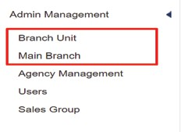
Part 2: Initial Setup: Admin Management (Branch & Main Branch)
STAGE - 1
On-boarding of corporate clients Create branch unit
Main branch
A. Step 1: Creating a Branch Unit
The Branch Unit form defines the top-level entity. Here, Onboards the corporate clients.
Field / Option | Usage and Description
Company Name | The operating entity (Qgo ).
Branch Unit | Enter the name for the new branch (e.g., 'FedEx’).
Type (Main/Corporate) | Main: Used for the central operating entity (Qgo). Corporate: Used for corporate clients who book travel (e.g.FedEx).
Credit Setting | Defines the financial terms of the branch. Crucial for controlling client spending.
Credit Limit | The maximum credit amount extended to this branch.
Credit Balance | Displays the real-time available credit for the branch.
Field / Option | Usage and Description
Period /Duration | Defines the validity period for the credit.
Notification Limit (in %) | The percentage threshold at which a notification email is sent regarding nearing the credit limit.
Reserve Amount Type | Select whether the remaining amount is tracked as an Amount or a Percentage.
Subdomain url | Allows to set subdomain for corporate
Branch logo | Allows the user to upload and set a logo specific to the branch. The selected logo will be displayed in branch(corporate panel)
Is Active | Check Is-Active to activate the branch unit.

Slide 11
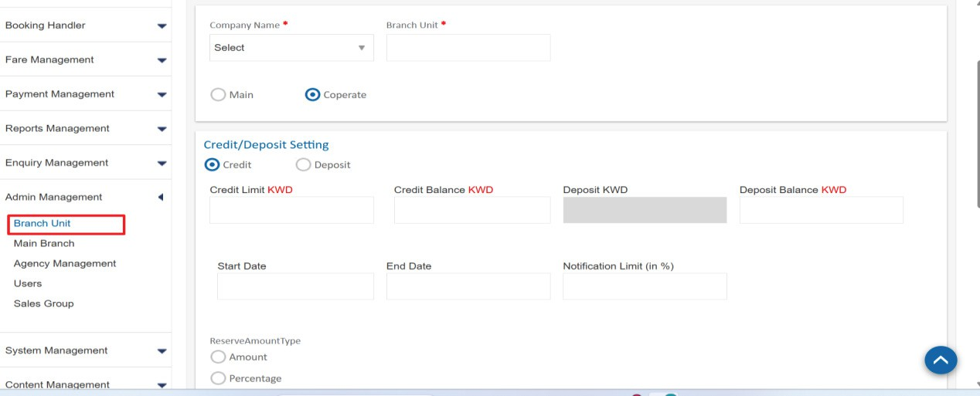
Note : The Reserved Amount is intended to be a separate pool, meaning it can be used directly for business travel without waiting for the
employee/department allocations to be emptied or It can be used even if the amounts allocated to departments or employees are not yet empty. It acts as a separate, central pool of funds.

Slide 12
Step 2: Creating a Main Branch
The Main Branch form is used to categorize the branches under branch unit and configure the operational and contact details for the established branch .This setup requires filling out distinct sections: Company Details, Contact Details
Contact Details & Settings
This section is vital for system notifications and support.
Company Details
Field / Option | Usage and Description
Company Name | Select the parent company from the dropdown.
Branch Unit | Select the Branch Unit name created in Step 1.
Main Branch Name | The specific name of this entity (e.g., 'FedEx Kuwait').
Address Line City Code | Geographical details for contact
Currency Code | The primary operational currency for this main branch (e.g., KWD).
Countries | Select the countries this Main Branch is authorized to operate in or book travel for. Use the arrow buttons to move countries between the available list and the selected list.
Agency Types | Define the operational role of this Main Branch (Travel Agent).
Field / Option | Usage and Description
Contact Person | The primary point of contact for this Main Branch.
Phone, Mobile, Email | Corresponding contact details. Use the Add More button to input multiple contact persons.
Notification E Mail 1 | Mandatory. The primary email address for receiving critical system alerts, booking confirmations, and financial notifications.
Notification E Mail 2 | A secondary or backup email address for alerts.

Slide 13
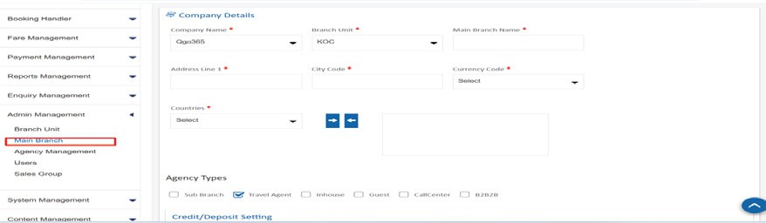
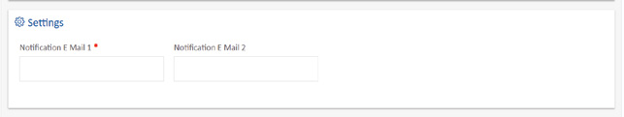

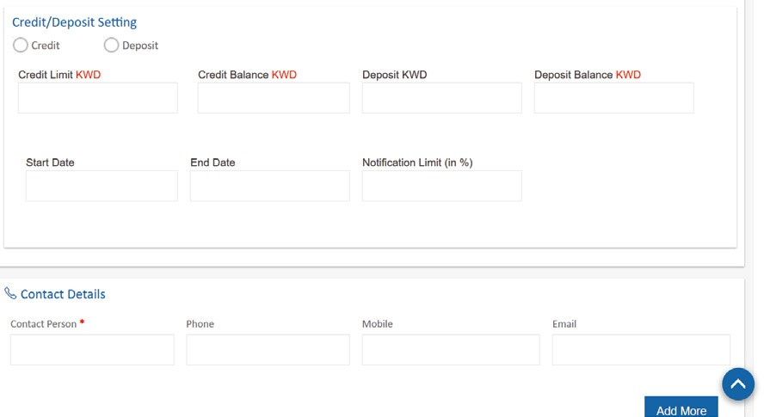
IS ACTIVE -if checked ,means active for use
After filling all required fields across the three sections, click Save to create the Main Branch.

Slide 14
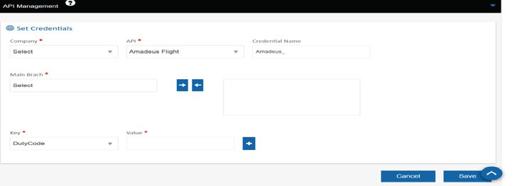
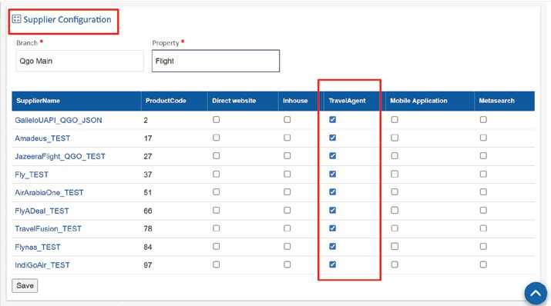
API MANAGEMENT CONFIGURATION
SUPPLIER CONFIGURATION
The API Management Set Credentials form, which is used to configure the API access keys for different organizational
branches after they have been created. This process is crucial for associating API usage with branch.Choose the main branch from dropdown and map each main branch to the respective APIs.The right arrow ( ) is used to assign/map the selected
main branch.The left arrow ( ) is used to remove/unmap the mapped main branch.
Enabling the supplier in the Supplier Configuration is the
crucial step after setting up the API credentials, then only it activates the provider
NOTE : Following the creation of the branch unit and main branches, a transition to the corporate admin branch is required to proceed with further onboarding process.

Slide 15
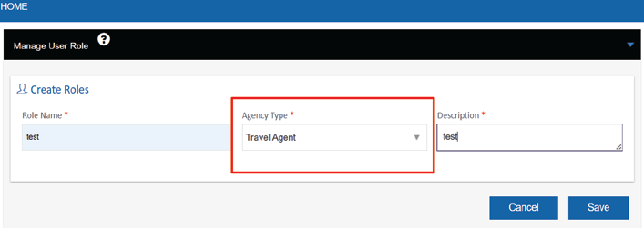
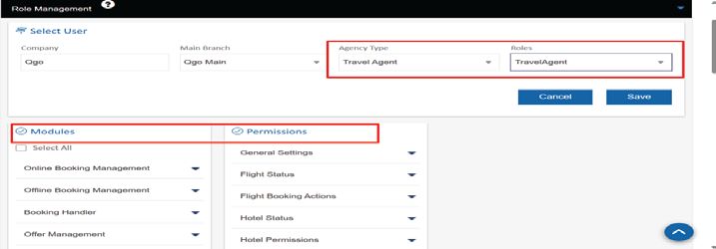
AGENCY TYPE - TRAVEL AGENT ROLE
MANAGE ROLE
Creating a role involves assigning a name, specifying its
operational type (Agency Type), and providing a description. Roles are crucial for managing permissions and access levels across the Corporate Booking Tool (CBT) .
After defining the "TravelAgent" role, the next crucial step is assigning the specific Modules and Permissions to ensure the Travel Agent can execute their duties.
Role Permissions Configuration for Travel Agent
This form manages the specific access rights for a user assigned the TravelAgent role, determining exactly what they can view and execute within the system.Without granting these permissions, the role will not function correctly.

Slide 16
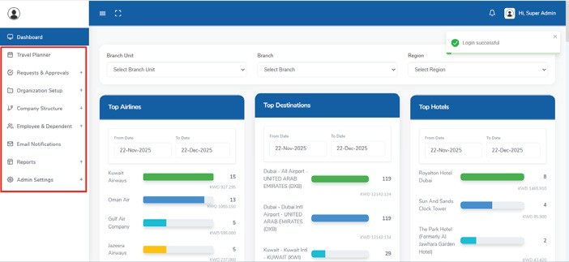
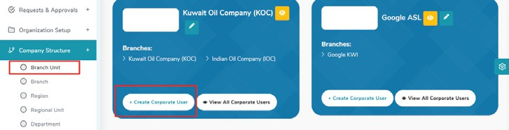
Company Structure
CORPORATE ADMIN GUIDE
The Company Structure section defines the organizational hierarchy of the company within the system. It breaks down the organization into
five key levels:
Branch Unit
Branch
Region
Region User
Regional Unit
Department
Branch Unit
It allows the admin to view all onboarded branch units
Corporate users must be created and mapped directly against the specific Branch Unit they belong to.
Corporate Admin Dashboard Navigation Contents
The following items are accessible after logging into the Corporate Admin system:
Dashboard
Requests & Approvals
Organization Setup
Company Structure
Employee & Dependent
Admin Setting
Corporate User form
Create and assign a new Corporate User within the admin panel. This process ensures the new user is correctly linked to their Branch Unit
and assigned the appropriate access role.

Slide 17
Credentials and Profile Setup
Profile Information
Complete the mandatory fields in the Profile section to establish the user's personal and contact information.
Field | Description
Title | Select the appropriate honorific (e.g., Mr., Ms.).
First Name / Last Name | Enter the user's full name.
Phone Code / Phone Numbe | Enter the full contact phone number, including the country code.
Email | Enter the user's corporate email address. This is a critical contact point for the system.
Credentials
Define the secure login information the user will use to access the platform.
Field | Description
Username | Enter the unique login identifier for the user (often the corporate email address).
Password / Confirm Password | Set and confirm a secure password for the new user's initial login.

Slide 18
Branch Unit
Field
Description
Branch Unit
Select the specific operational group (Branch Unit) to which the new user belongs (e.g., Kuwait Oil Company (KOC)). This assignment determines the user's scope of work and data visibility.
Role
Field
Description
Role
Select the primary access role for the user. By default, this is the Corporate User role, which defines their general access level and permissions within the system.
Profile Picture
This section is for uploading an image associated with the user's profile within the system.
Field
Description
Choose File
Allows the administrator to select and upload a profile image (photo) for the new user. This field is typically optional but recommended for personalized user experience.
Status
This section defines the initial operational status of the user account upon creation.
Field
Description
Status
Sets the current accessibility of the user account. The default and standard setting is Active, meaning the user can immediately log in and access the system upon completion.

Slide 19
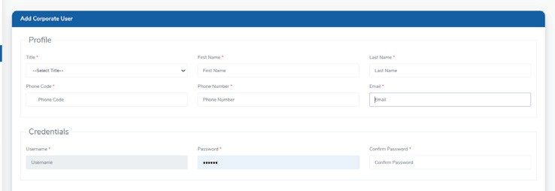
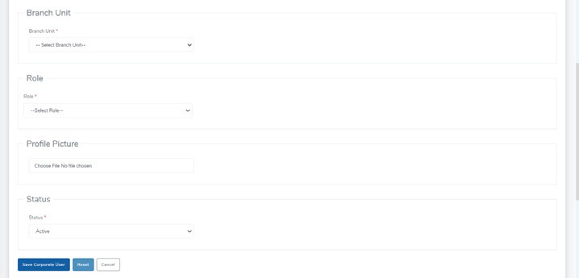
Action Buttons
Once all necessary fields are complete, the following actions can be taken:
Button | Function
Save Branch User | Submits all entered data and finalizes the creation of the new user account, making it immediately available for login (if Status is Active).
Reset | Clears all data entered in the form fields, allowing the administrator to start the process over.
Cancel | Exits the user creation form without saving any changes.

Slide 20
Branch
Function: It is used to view all established branches Region Creation in Branch Form
Automatic Creation Option
Upon clicking the Create Region button, a prompt will display: "Do you want to create Region and Regional Unit automatically?"
Option | Action | Outcome
YES | Select YES to automatically generate the Region and Regional Unit structures. | The new Region and Regional Unit are created instantly. The system will automatically assign the credit balance to these new units, inheriting the limits set for the main Branch to ensure immediate operability.
Manual Creation Option
Option | Action | Outcome
NO | Select NO to proceed with a manual setup. | The creation process becomes manual. The corporate user must individually enter all required Region and Regional Unit details. Setting a specific credit limit for these manually created units is optional.

Slide 21
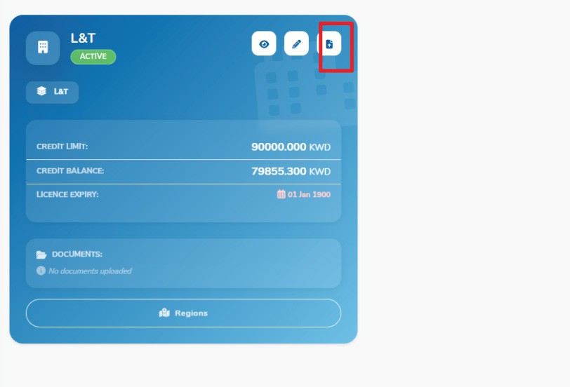
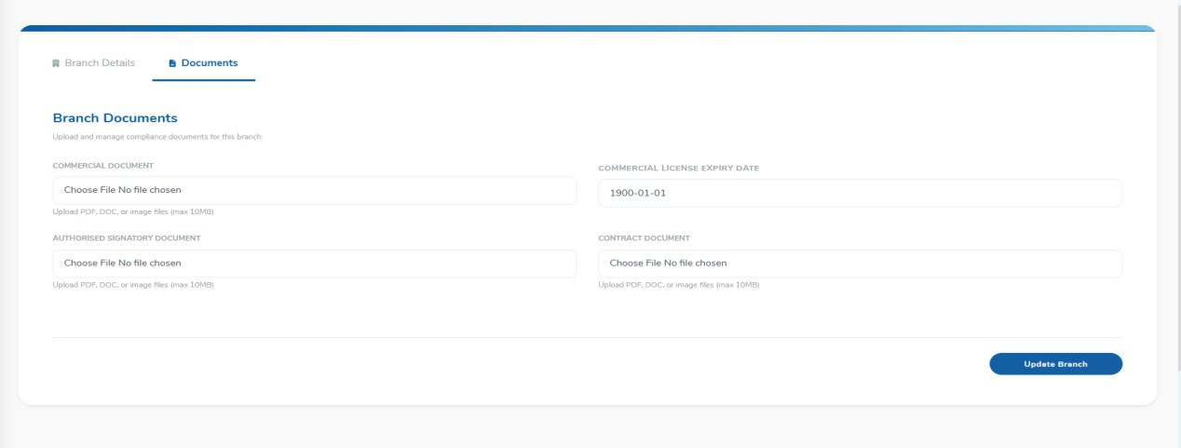
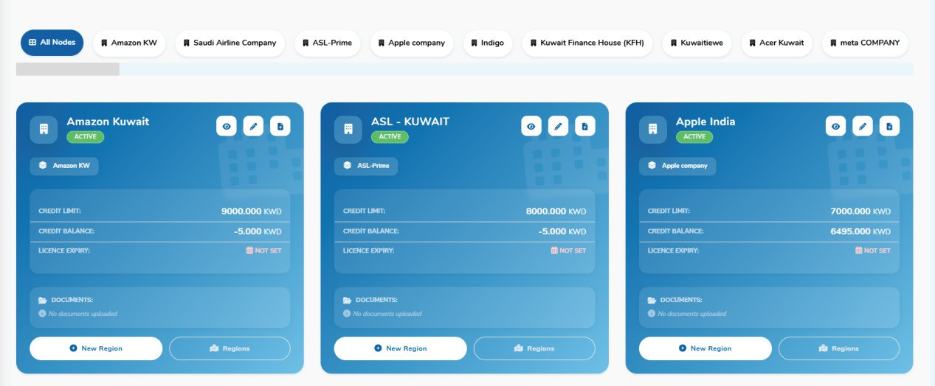
Document upload

Slide 22
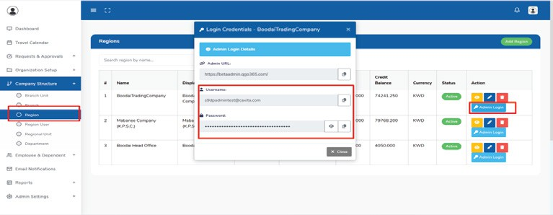
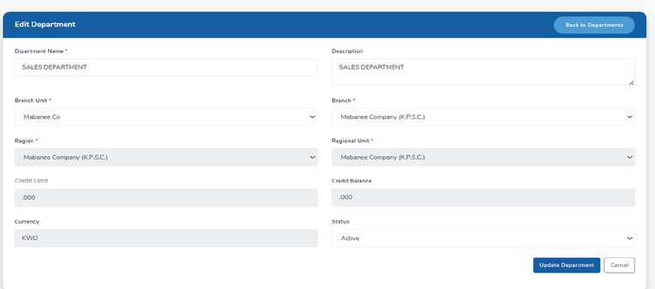
Region User
DEPARTMENT
This form is used to establish a new Department within the organization's structure. Crucially, the Department must be linked to the relevant existing organizational entities, ensuring it is positioned correctly in the company hierarchy.

Slide 23
Department Details
These fields define the identity and basic information for the new department.
Field | Description | Requirement
Name | The formal, unique name of the Department. | Mandatory
Display Name | A shortened or client-facing name for the Department, used in reports and headers. | Mandatory
Description | A brief explanation of the Department's function or purpose. | Optional
Organizational Mapping
This section is essential for linking the new Department to the established company structure, ensuring it is created against the Regional Unit.
Field | Description | Requirement
Branch Unit | Select the Branch Unit that oversees this Department. | Mandatory
Branch | Select the primary Branch under which this Department falls. | Mandatory
Region | Select the Region where this Department is geographically or functionally located. | Mandatory
Regional Unit | Select the specific Regional Unit that this Department is created against. | Mandatory

Slide 24
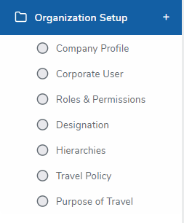
Financial and Status Details
These fields finalize the operational and financial settings for the Department.
Field | Description | Requirement
Credit Limit | Enter the maximum financial allowance or budget for the Department's operations. | Optional
Status | Sets the initial operational status. Typically set to Active to allow immediate use and allocation of users. | Mandatory
ORGANIZATION SETUP
The next process is Organization Setup. This section is a central hub for defining the foundational administrative rules and user entitlements for the entire system.
Corporate Profile
Corporate User
Roles & Permissions
Designation
Hierarchies
Travel Policy
Purpose of Travel

Slide 25
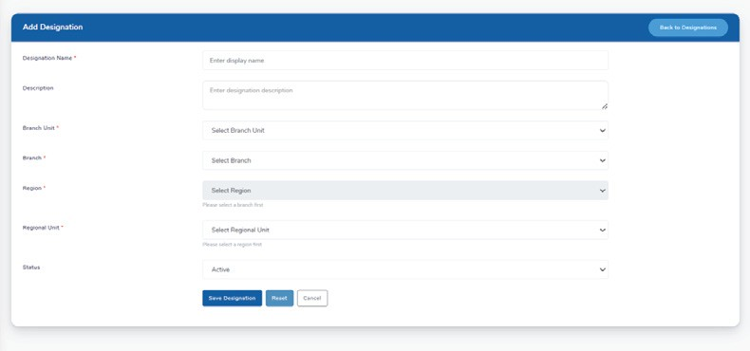
Starting with Designation creation in the Organization Setup section
DESIGNATION CREATION FORM
This form is used to define and set up the job titles (Designations) within the system. These designations will be assigned to Corporate Users to accurately reflect their role and position in the company hierarchy.
Designation Details
The following fields establish the identity and operational status of the new designation.
Field | Description | Requirement
Name | The official, formal job title or name of the designation (e.g., Senior Manager). | Mandatory
Description | A brief explanation of the responsibilities or purpose of this designation. | Optional
Status | Sets the operational status. Set to Active to make the designation immediately assignable to users. | Mandatory (Selection)

Slide 26
The next step is creating the Hierarchy flow, which is crucial for establishing the approval structure within the system.
HIERARCHY FLOW CREATION
This form is used to define the Approval Workflow Hierarchy for a specific department. The hierarchy determines the reporting structure and the order in which requests must be approved.
Hierarchy Details
The hierarchy flow is created against each Department to ensure that approval steps are specific to that group's operational needs. The flow is built based on Designations (job titles).
Field | Description | Purpose
Department | Select the specific Department (e.g., Operations) for which this approval hierarchy will apply. | Mandatory
Hierarchy Level | This field defines the specific level or step within the hierarchy (e.g., Team Lead Operations). This level is typically based on a defined Designation. | Mandatory
Hierarchy | Select the next reporting level or individual in the approval chain to whom the current level reports. | Mandatory
Description | A brief explanation of the approval flow for this level. | Optional

Slide 27
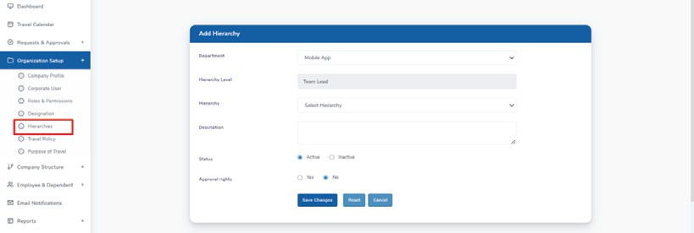
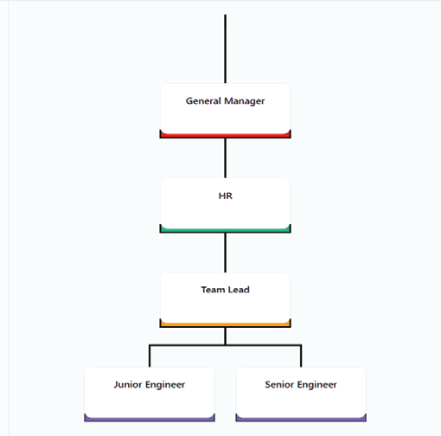
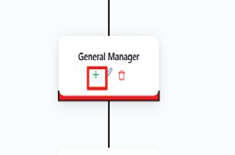
Status and Approval Rights
These fields finalize the operational status and function of this specific hierarchy level.
Field | Description
Status | Sets the operational state of this level in the flow. Select Active to enable it for use in approval workflows.
Approval rights | Determines if the user at this hierarchy level has the authority to approve requests: Yes grants approval power, while No means they are only a reviewer or reporting level.

Slide 28
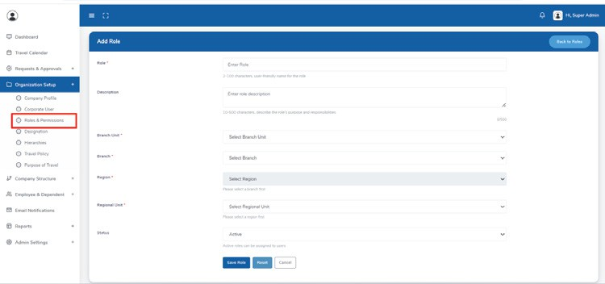
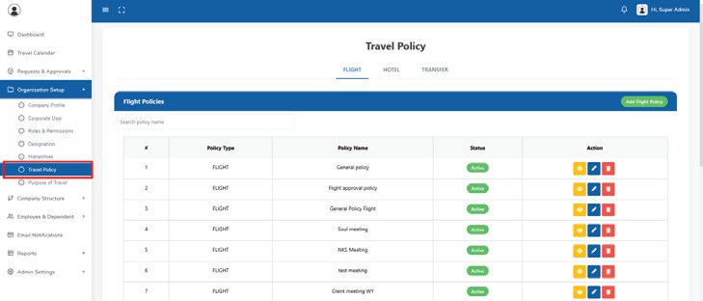
ROLES AND PERMISSION
Role creation and assigning permissions against the role.
ROLES AND PERMISSION
Travel Policy Management
This page allows the Admin to define, manage, and assign
various travel policies (Flight, Hotel, and Transfer) to different users or groups within the organization. These policies enforce
corporate spending limits, class of travel restrictions, and other compliance rules directly within the booking tool.

Slide 29
Creating a New Travel Policy
This form is where you define the specific rules and restrictions for employee travel. Parameters on the left can be drag and drop selecting a Policy Type, can create a highly customized policy that automatically guides employees toward compliant bookings.
Select the Policy Type
First, determine the scope of this policy by selecting one of the radio buttons:
General Policy: This is the default policy that applies to all employees unless a more specific policy (Role Based or Department Based) overrides it. Use this for company-wide standards.
Role Based Policy: Select this if the policy will apply only to employees with a specific Designation or Role (e.g., only "Executives" are allowed Business Class).
Department Based Policy: Select this if the policy will apply only to employees belonging to a specific Department (e.g., the "Sales" team has a different lodging budget than the "IT" team).
Define the Policy Criteria (The Rules)
Use the buttons on the left (highlighted in red) to define the specific rules and restrictions this policy will enforce. Drag and drop these buttons will open configuration fields where you can add, remove, or restrict options:
Complete Flight Policy Parameter Definitions
This table defines all available criteria for setting rules within a corporate travel policy for flight bookings.

Slide 30
Parameter | Purpose & Content | Example Policy Application
Route | Geographical restrictions based on origin, destination, or connections. | Prevent booking a flight from restricted routes
Haul Type | Define rules based on the duration of the journey | If any segment duration exceeds the configured haul type (e.g., > 6 hours): system allows user to upgrade to higher class.
Cabin Class | Set the maximum allowed class of service for travelers under this policy. Options include Economy, Premium Economy, Business, or First Class. | Only Executives are permitted to book Business Class for international travel.
Travel Purpose | Tie the policy to the Reason for Travel selected by the employee during the booking request. | Apply stricter cost limits for 'Training' trips than for 'Client Visit' trips.
Carrier Type | Restrict or mandate the use of specific airlines based on their service category (e.g., Full-Service vs. Low-Cost). | Restrict the use of Low-Cost Carriers to ensure a consistent travel experience for employees.
Flight Arrival Preference | Define preferred or restricted arrival times for the traveler. | Restrict booking flights that arrive between 1:00 AM and 5:00 AM to avoid impacting the traveler's first day of business.
Preferred Airlines | Designate specific airlines that employees must prioritize, typically based on corporate negotiated rates or loyalty programs. | Mandate booking with the company's preferred vendor.
Restricted Airlines | Explicitly block certain airlines from being booked due to safety ratings, poor service history, or other corporate decisions. | Block all bookings on Airline X due to recent service complaints.
Group Or Individual | Set rules differently depending on whether the booking is for a single person or a larger group traveling together. | Allow for a higher ticket price threshold when the booking is for a Group of 5 or more travelers.

Slide 31
Complete Policy Details
Fill in the required information to activate and manage the policy:
Purpose of Travel: (If applicable) Select the specific travel purpose this policy is tied to or can choose multi purpose of travel
Policy Name: A clear, concise name (e.g., 'Managers - Domestic Economy Policy').
Description: A brief summary of what the policy covers (e.g., 'Applies to all managers for domestic travel only. Restricts flights to 4-star hotels.').
Effective From/To Date: Define the period during which this policy will be active and enforced.
Active Toggle: Ensure the 'Active' switch in the top-right corner is ON to apply the policy immediately after saving.
TRAVEL PURPOSE FORM
This form is used by the Admin to define and manage the standardized list of reasons for employee travel. These defined purposes are then linked to
specific Travel Policies.
Name: Enter a user-friendly name for the travel purpose (e.g., Client Meeting, Annual Conference, Internal Audit). This is the name employees will see in the booking tool.
Property: Multi-select dropdown allowing selection of applicable modules (Flight, Hotel, Transfer).
  Branch Unit – Dropdown to select the relevant branch unit.
  Branch – Dropdown to select the applicable branch.
  Region – Dropdown to select the associated region.
  Regional Unit – Dropdown to select the regional unit.

Slide 32
Sort Order
Enter a numerical value to determine where this purpose appears in the dropdown list.
Status
Select the status. Choose Active to make this travel purpose immediately available for use in employee travel requests. Click Save Travel Purpose to add the new entry to the system.
Hotel Policy Parameter
Parameter | Purpose & Content | Example Policy Application
Preferred Hotel | Designate specific hotels or hotel chains that employees must prioritize due to corporate agreements or cost efficiency. | Mandate that employees book a room at the 'Global Stay' chain if available, to maximize corporate discounts and rewards.
Restrict Hotel | Explicitly block certain hotels or hotel chains from being booked, often due to high cost, poor location, or lack of corporate services. | Block all luxury hotels with a nightly rate exceeding the maximum price limit of the policy.
Star Rating | Set the minimum and/or maximum star rating for hotels that employees are allowed to book. | Require all hotel bookings to have a minimum rating of 3 Stars and a maximum rating of 4 Stars.
Set Hotel Room | Define the specific room type (e.g. standard, executive, suite) that employees are allowed or restricted from booking. | Set the default booking to a Standard Room only, regardless of the traveler's designation.
Restrict Hotel Room | Explicitly block certain, usually premium, room types (e.g., suites, rooms with special views) from being selected. | Restrict the booking of Executive Suites for all staff below the Vice President level.
Board Type | Specify the meal plan or board basis that is allowed or required for the booking (e.g., Room Only, Bed and Breakfast, Half Board). | Mandate that the booking is for Bed and Breakfast (B&B) to ensure the traveler has a meal before starting their day.

Slide 33
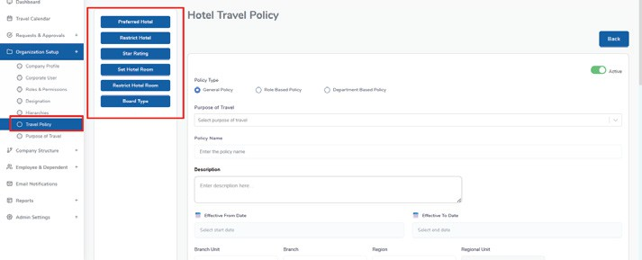
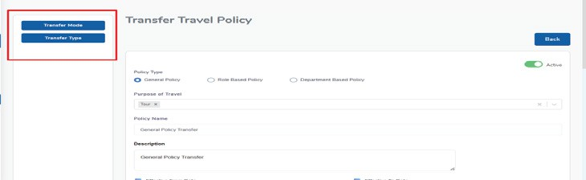
Transfer Policy Parameter
Parameter | Purpose & Content | Example Policy Application
Transfer Mode | Define the type of vehicle that is allowed (e.g.,standard, premium). | mandate the booking of Standard for all staff below the Director level
Transfer Type | Define the range of the transfer (e.g., shared,private) | Can be shared or private.
Employee & Dependent
Manage Employee
Manage Dependent
This process, accessed via Manage Employee, is for onboarding new corporate employees. It is crucial to follow the highest authorized
person first principle, meaning Reporting Managers and high-level Designations/Roles must be created before their subordinates to ensure the approval and reporting hierarchies are correctly established.

Slide 34
Employee & Dependent: Corporate Employee Onboarding
The Employee Onboarding form integrates new users into the system, mapping them to the organization's structure and defining their access and financial settings.
Profile Information
This section captures the mandatory personal and official contact details for the employee.
Field | Description | Requirement
Employee No | The unique company identifier for the employee. | Mandatory
Title, First Name, Last Name | The employee's full name. | Mandatory
Official Phone Code / Number / Email | The employee's official work contact details. | Mandatory
Personal Phone Code / Number / Email | The employee's personal contact details. | Non-Mandatory
Nationality | The employee's nationality. | Mandatory
Address | The employee's physical address. | Non-Mandatory
Credentials
This section defines the user's login access.
Field | Description | Requirement
Username | The unique identifier for login (e.g., qgorequest@qgo365.com). | Automatic generation of above above given givem email id- Mandatory
Password / Confirm Password | Set and confirm the initial secure password. | Mandatory

Slide 35
Role & Reporting (Critical Section)
This is the most critical section as it links the employee to the pre-configured organization structure and reporting flow.
Field | Description | Dependency Notes
Branch Unit, Branch, Region, Regional Unit | Defines the employee's location and organizational mapping. | Selection cascade: Branch selection is needed before Region, and so on.
Department | Select the specific Department the employee belongs to. | Mandatory
Designation | Select the employee's job title (from Organization Setup). | Mandatory
Role | Select the employee's system access role (e.g., Corporate User, Approver). | Mandatory
Reporting Manager | Select the employee's direct manager from the list of existing, onboarded employees. | HIGH PRIORITY: The manager must be onboarded first to appear in this list.
Document Details
This section captures mandatory travel and identification documents.
Field | Description | Requirement
Passport Number | The unique passport number. | Mandatory
Passport Expiry Date | The date of the passport expires. | Mandatory
Passport Issued Country | The country that issued the passport | Mandatory

Slide 36
Credit Settings and Status
Field | Description
Profile Picture | Option to upload a photo for the user's profile.
Credit Limit | The specific financial limit allocated to this employee, which auto-populates based on the selected Department's settings.
Currency | The operational currency for the employee, which auto-populates based on the Department's setup.
Status | The account's operational state. Set to Active to allow the employee to log in immediately.
Document Details
This section captures mandatory travel and identification documents.
Field | Description | Requirement
Passport Number | The unique passport number. | Mandatory
Passport Expiry Date | The date of the passport expires. | Mandatory
Passport Issued Country | The country that issued the passport | Mandatory

Slide 37

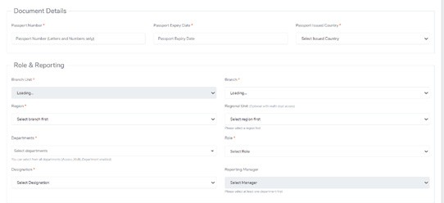
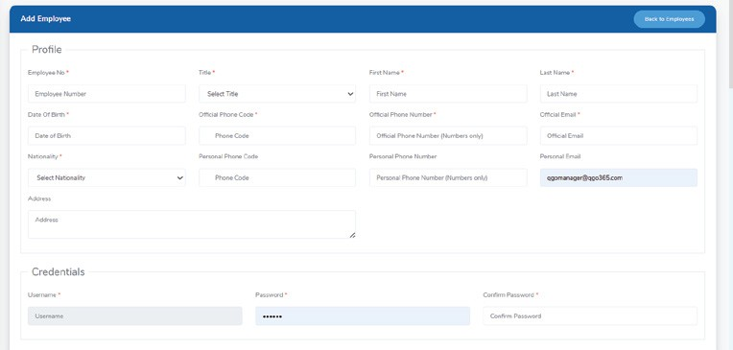
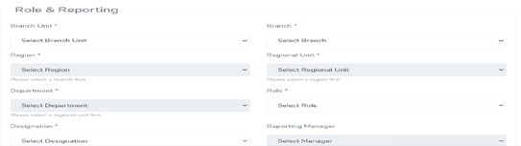
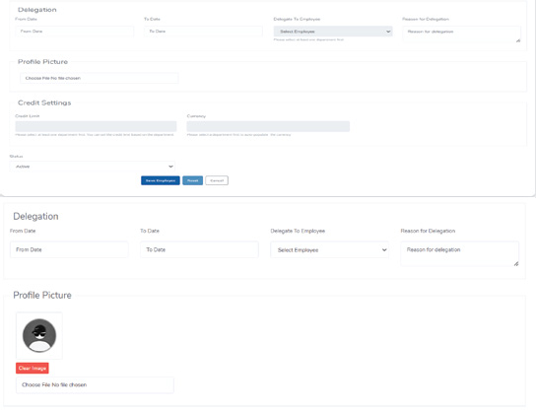
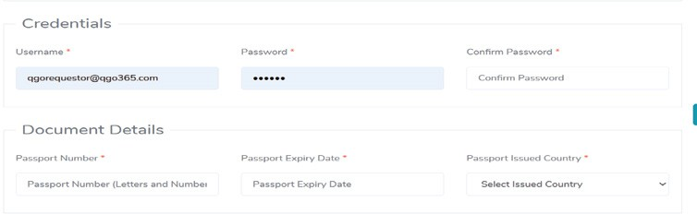


Slide 38
The Delegation feature allows an employee to temporarily assign their approval authority to another employee for a specified period. This ensures continuity of operations during absences such as leave, travel, or unavailability.
Fields Description From Date
Select the start date from which the delegation will be effective.
To Date
Select the end date until which the delegation will remain active. After this date, delegation will automatically expire.
Delegate To Employee
Choose the employee to whom the responsibilities and approvals will be delegated during the selected period.
Reason for Delegation
Enter the reason for delegating responsibilities (e.g., leave, business travel, unavailability).
Functionality:
During the delegation period all approvals, and requests assigned to the delegator will be routed to the selected delegate. Delegation is date-bound and automatically deactivates once the end date is reached.
This feature ensures uninterrupted workflow and timely approvals without manual intervention.

Slide 39
MANAGE DEPENDENT
The Manage Dependent module allows employees or administrators to add and maintain dependent details for travel purposes.
Add Dependent:
Capture personal details such as name, date of birth, contact information, and nationality. Enter passport details including passport number, expiry date, and issued country.
Set the dependent status as Active or Inactive.

Slide 40
REQUEST AND APPROVAL
This section details the process for handling all Requests & Approvals submitted by employees through the Corporate Booking Tool (CBT).
Request Initiation: The employee submits a travel request through the Corporate Booking Tool (CBT).
Request Routing: The submitted request is automatically routed to the designated Manager or Approver within the Corporate Admin Panel based on the organization's pre-defined approval structure (e.g., Level 1, Level 2).
Review and Action: The designated Approver logs into the Corporate Admin Panel and navigates to the 'Approval Requests' section. Here, the approver must review the request details, and either Approve or Reject the request.
Note: If the request requires multiple approvals (multi-level), it will proceed sequentially until all levels are approved or a rejection is issued.
Completion of Booking:
Upon Approval: Once the request receives the final required approval, the employee
must log back into the CBT to proceed with and
complete the ticketing process (e.g., payment, final confirmation).
Upon Rejection: If the request is rejected at any level, the employee must submit an entirely new request.

Slide 42
SEND QUOTE
An employee can send one Quote Request with up to three quotations.
Multiple quotations (maximum 3) are allowed within a single quote request.
Once submitted, the shared quote request along with all quotations will be visible in the Quote Requests listing for review and approval.
Employee ID – Displays the employee identifier.
Requested By – Shows the requester’s name/designation.
Submission Date – Date on which the quote request was submitted.
Details – Displays airline options with route details.
Amount – Shows the quoted amount.
Approval Levels – Displays approval hierarchy and current approval status per level.
Current Status – Shows the overall request status (e.g., Awaiting Approval, Payment Done).
View History – Button to view approval and status history.
After the quote is approved, the user should be required to log in to the CBT web portal. Once logged in, the user must proceed to the
Booking Form and complete the booking from quote request

Slide 43
Travel calendar
The Travel Calendar provides a calendar-based view of planned and ongoing travel activities.
Details Displayed
Employee Name,Source and Destination,Purpose of Travel
Each travel request is shown on the respective travel dates for easy tracking and visibility.

Slide 44
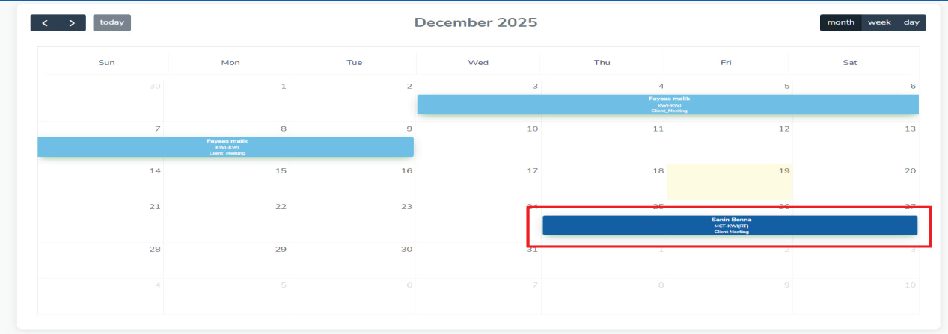
Access & Visibility:
An employee can view their own travel details in the calendar.
A Reporting Manager can view:
Their own travel details, and
The travel details of all employees under their department.

Slide 45
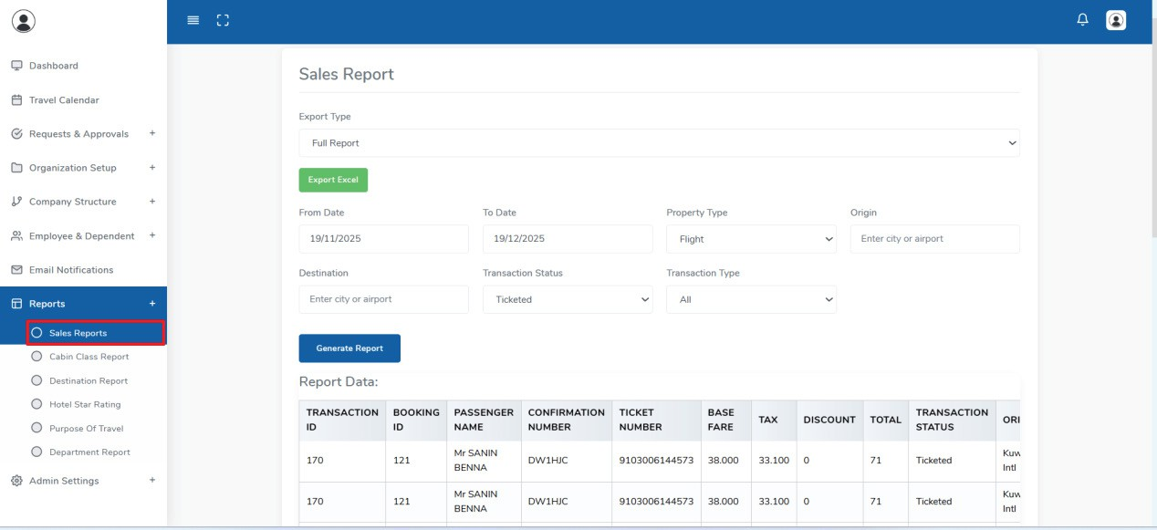
MANAGE DEPENDENT
The Reports module provides insights into travel bookings, expenses, and patterns across the organization.
Available Reports
Sales Report: Displays sales details and revenue generated from travel bookings.
Cabin Class Report: Shows booking distribution based on cabin class (Economy, Business, First, etc.).
Destination Report: Provides insights into frequently traveled destinations.
Hotel Star Rating Report: Displays hotel bookings grouped by star rating.
Purpose of Travel Report: Shows travel revenue categorized by the purpose of travel (e.g., Client Meeting, Team Meeting).
Department Report: Displays travel data and expenses grouped by department.
Non-AirReport: Displays consolidated revenue details for non-air bookings(Hotel,Transfer,Train,Rental car).

Slide 50

REACH CAXITA
INDIA
Kochi
BAHRAIN
Manama
EGYPT
Cairo
www.caxita.com
info@caxita.com

